Slide 1
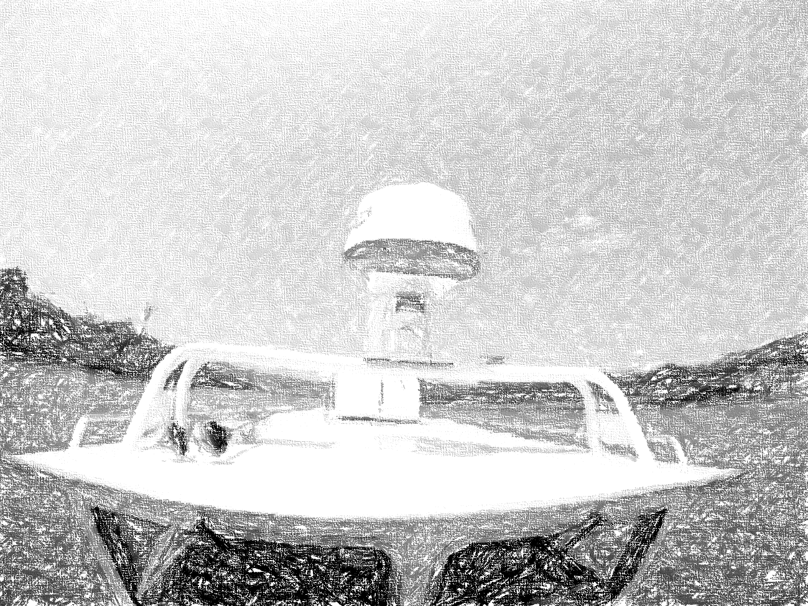


Autonomous Water Taxi
Preliminary Design Review
By: AutoPirates
Date: 05th November 2015
Project Sponsors:
Team B: Tushar, Shiyu, Bikramjot, Tae-Hyung, William

Slide 2
Content
Project description
Use case/System graphical representation
System-level requirements
Functional architecture
Cyber-physical architecture
Subsystem descriptions
Current system status
Project management

Slide 3
Project Description

Slide 4
Project Description
Problem
Pittsburgh lacks a viable river transportation system
Many attractions are located along the river
Currently, only luxury cruise lines available
Solution
AutoPirates is an autonomous water taxi service
A pleasant way to commute to work
More efficient than automobiles in reaching riverfront locations

Slide 5
Use Case

Slide 6

Use Case: System Graphical Representation
James would like to spend a nice day with his family, beginning with some shopping at Walmart, followed by an exciting game at PNC Park, and finally a nice dinner at the Cheesecake Factory in Southside Works.

Slide 7


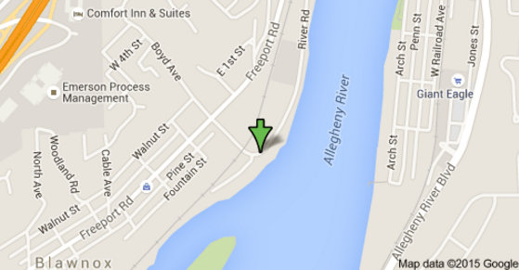
Use Case: System Graphical Representation
Welcome James!
Where you want to go today?
James books the cab from AutoPirates iOS app.
Your Location : Monongahela
Destination : Southside Works
Estimated Fare : $13
Book Now
Powered by AutoPirates

Slide 8
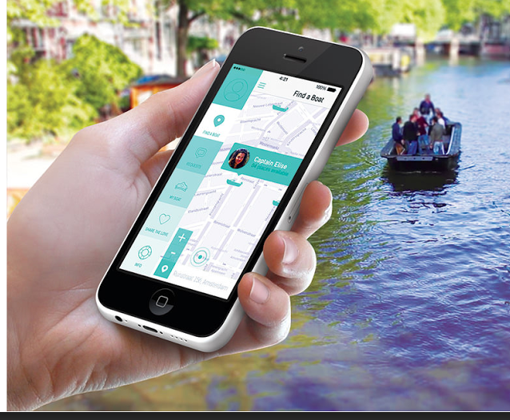
Use Case: System Graphical Representation
Boat arrives to pick James family

Slide 9
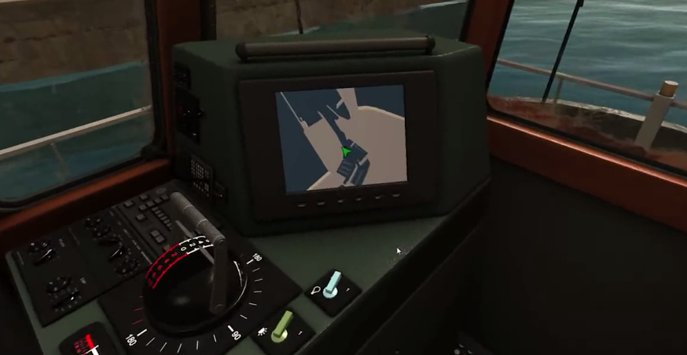
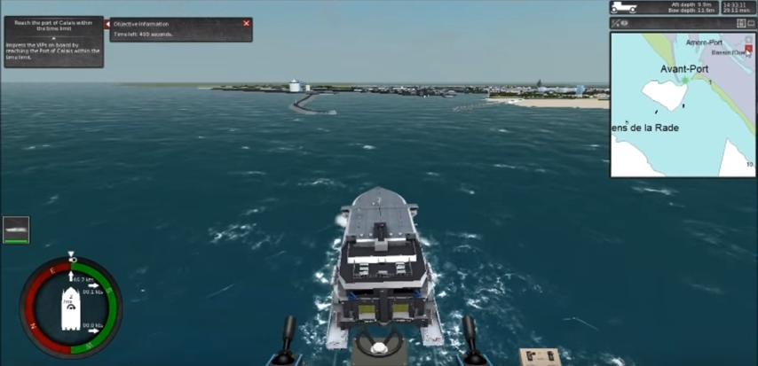
Use Case: System Graphical Representation
James confirms the destination on Operator Control Unit (OCU)
OCU also shows the path to his destination

Slide 10
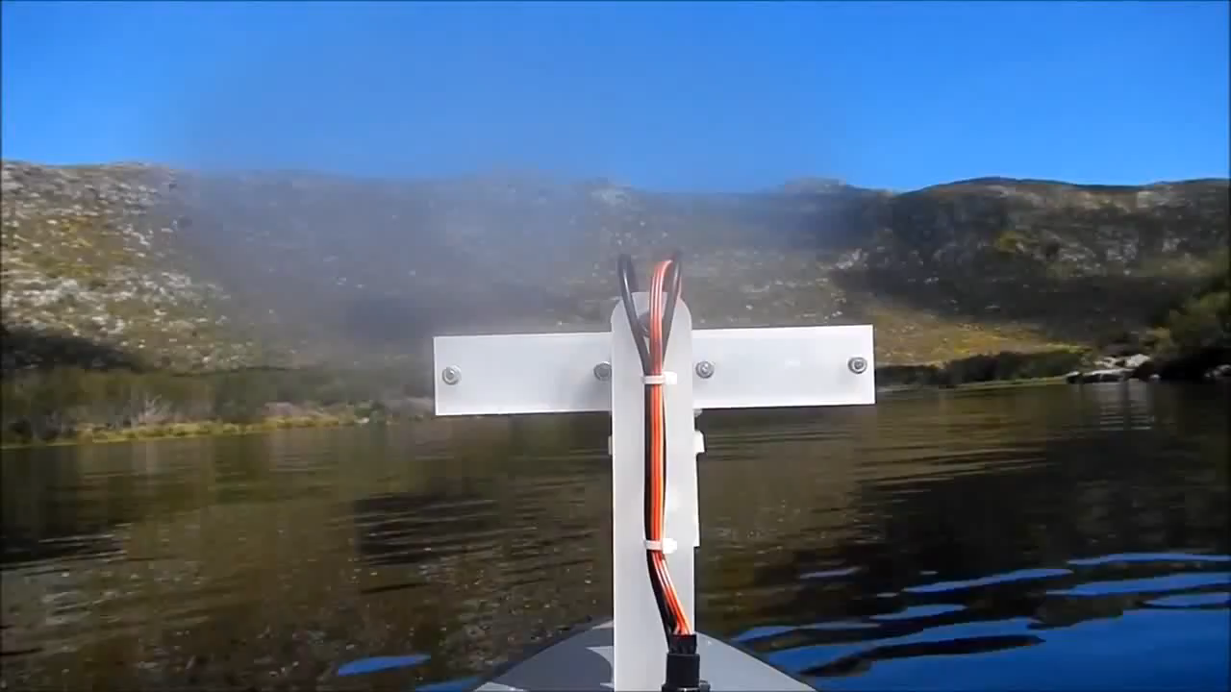
Use Case: System Graphical Representation
Boat avoids obstacles in between the path

Slide 11
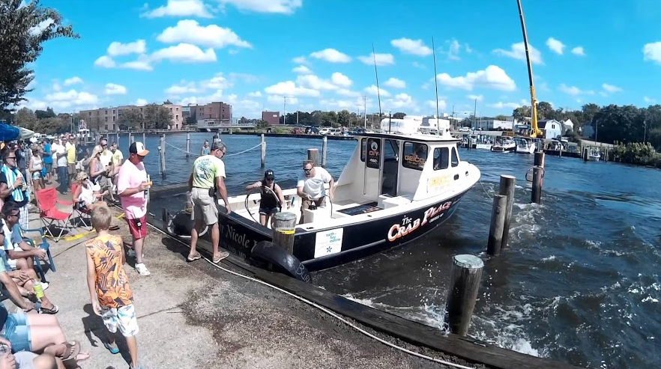
Use Case: System Graphical Representation
The destination arrives

Slide 12
Requirements

Slide 13
System Requirements: Mandatory Functional
The system shall
MF1. Control throttling and steering of the boat.
MF2. Detect static obstacles in the river with minimum size of 2mtx2mtx2mt with more than 85% accuracy.
MF3. Detect shores with more than 85% accuracy.
MF4. Autonomously navigate from source to destination at the maximum distance of 2 miles in not more than 15 minutes.
MF5. Avoid detected static obstacles with an accuracy of more than 95%.
MF6. Update the path within 5 sec after detecting new static obstacles.
MF7. Record sensor data up to duration of 15 minutes.
MF8. Replay saved sensor data.
MF9. Have a 2D simulator to test path planning algorithm.

Slide 14
System Requirements
Desirable functional requirements
The system shall -
DF1. Track dynamic obstacles with minimum size of 1m x 1m x 1m.
DF2. Update the path within 2sec after detecting new dynamic obstacles.
Mandatory non-functional requirements
The system shall -
MNF1. Be tested in 25-30 field trials.
MNF2. Arrive within a radius of 15 meters of the desired destination.
MNF3. Be demonstrated in a video.
MNF4. Sail at a velocity not more than 15 mph.
Desirable non-functional requirements
The system shall -
DNF1. Obey the “rules of the road”.
DNF2. Estimate the shape of the static obstacles in the river with a minimum of 50% overlap.

Slide 15
Architectures

Slide 16
Functional Architecture: Defining functions of the project
Log Data
No
*Not in planned scope
Destination reached?
Get current location and localize
Plan route from current location to destination
Send commands to controller
Autonomously sail to destination
IMU/GPS
Yes
User Input
Get destination
Destination
Detect Dynamic Obstacles*
Estimate path of obstacle*
Planning
Acquire data from Sensors
Filter data
OCU
Radar
Detect Static Obstacles
Perception
Log Data
Log Playback

Slide 17
Functional Architecture: Functioning with logged data and simulator
No
Destination reached?
Get current location and localize
Plan route from current location to destination
Autonomously sail to destination in simulator
Logged IMU/GPS
Yes
Input (Config params)
Get destination
Destination
Planning
Acquire data
Filter data
Detect Static Obstacles
User Input
Logged Radar Data
Perception
Log Playback

Slide 18
Cyberphysical Architecture
Da
Data Acquisition System
Da
Da
Software System (Laptop)
OCU (Laptop)
Radar (Simrad 4G FMCW)
Raw Radar Data
Perception Algorithm
Destination Input from User on GUI
Da
Da
Low Level Controller
(ARM based proprietary FPGA board of NREC)
Single Board Computer
(SBC running Linux and connected to LAN (Based on ROS))
Obstacles Data
IMU/GPS (Novotel Span)
GPS/IMU Input and Output
Publish IMU/GPS data as ROS TOPIC
LAN
Path Planning Algorithm
Display Map and current Location
Control Throttle and steering
Send Commands to control boat
Send GPS waypoints to control boat (ROS Topic)
LAN
Same or different Laptop or Tablet as in software system
Development using ROS in C++
Engine and Steering Controller (Inbuilt)
Da
Engine and steering controller
Engine (Twin 150 HP Engine) and Steering
SeaHawk OS 2700S

Slide 19
Subsystems

Slide 20
Subsystem: Perception
Log Data
Interface with ROS
Ego motion compensation
Data Filtering
Morphological operation (open/close)
Acquire data using OpenCPN
Obstacle Data Object
Object Detection (Boundary box)
Contour Extraction
Radar Data
Path Planning Algorithm

Slide 21
Subsystem: Path Planning
Obstacles data from perception algorithms
Log Data
IMU/GPS
Data from ROS Topic (SBC)
Get current location
Filter and localize
Add obstacles to Occupancy Grid Map
Path Planner
Operator Control Interface (OCU)
Create Occupancy Grid Map of environment
Send GPS waypoints to SBC
Get GPS waypoints of next grid location
Single Board Computer (SBC)

Slide 22
Subsystem: Simulator
Sample obstacle data for testing
Recorded data (ROS Topic)
Get current location
Localize
Add obstacles to Occupancy Grid Map
Path Planner
Visualization of path
Create Occupancy Grid Map of environment

Slide 23
Current Status

Slide 24
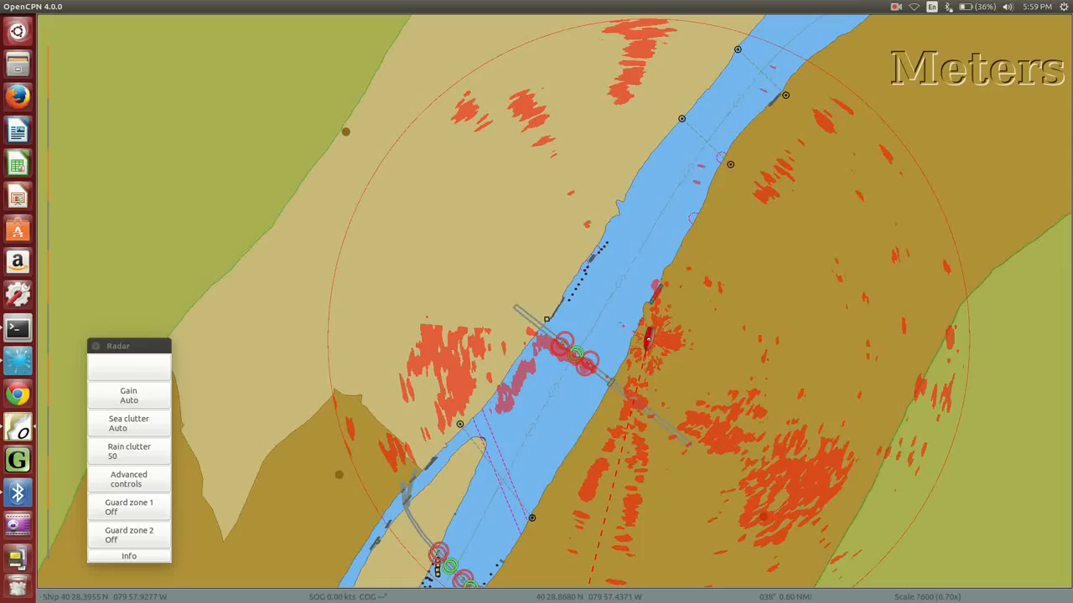
Current Status: Perception
Integrated Radar with OpenCPN library

Slide 25
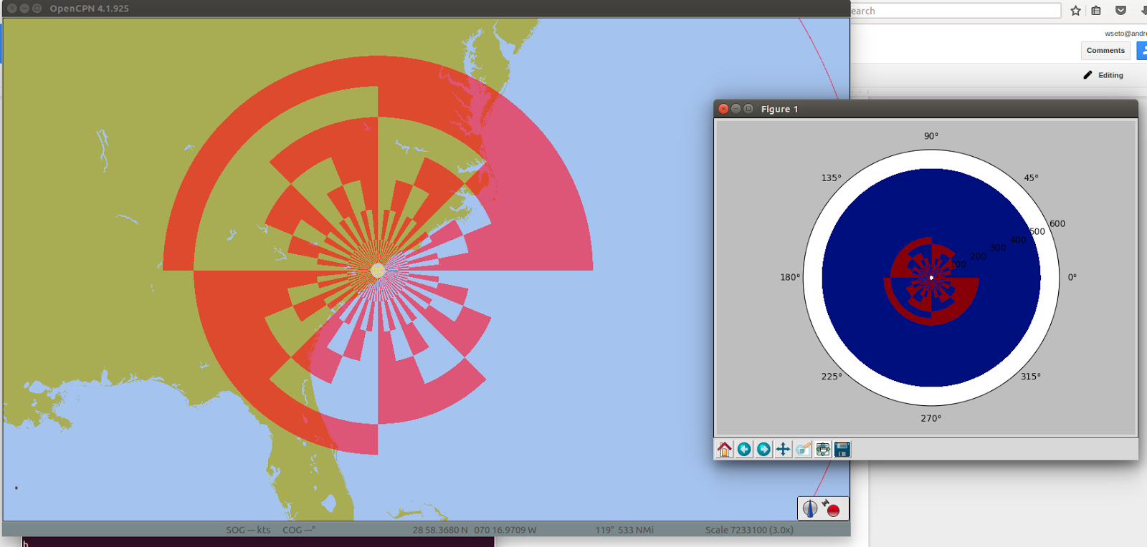
Current Status: Perception
Integrated Radar to receive RAW data and visualized the data using ROS Node
Working to filter raw data collected from Radar

Slide 26
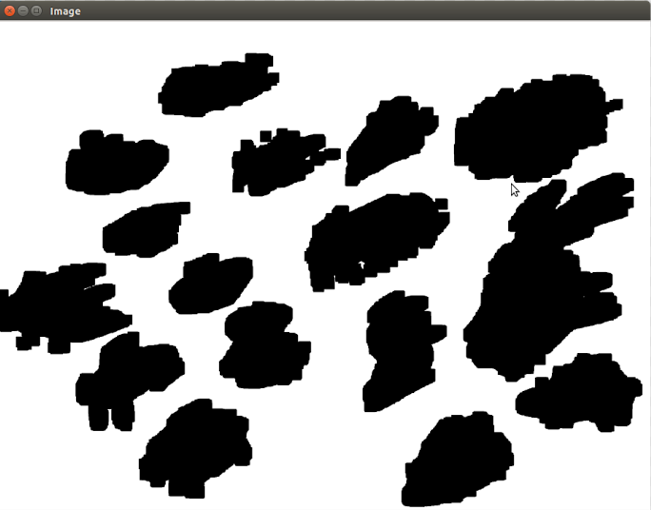
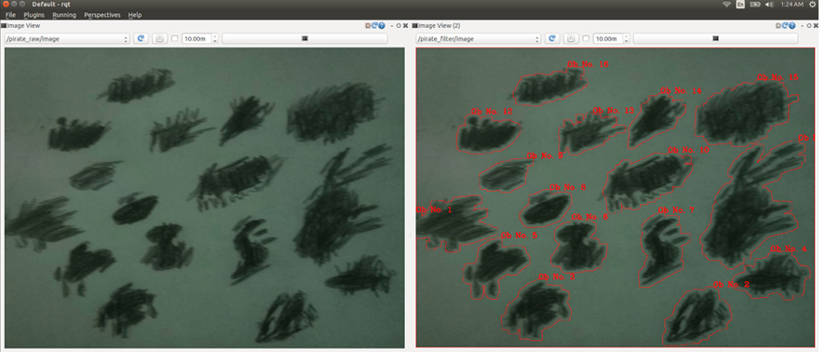
Current Status: Perception
Noisy Image -> Morphological Operations -> Contour Extraction -> Object Detection

Slide 27
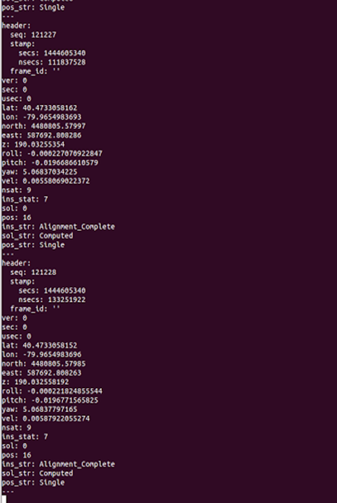
Current Status: Path Planning
IMU/GPS Interfacing (Subscribed to ROS topic)
Functionality to log IMU Data

Slide 28
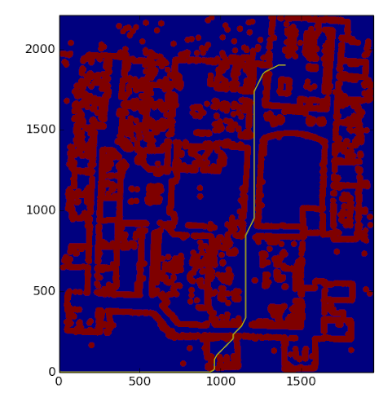
Current Status: Path Planning
Implemented A* code in C++ using library having high performance
Built samples from SBPL libraries with different environment configurations and planners
Working on creating occupancy grid map of the location of river where we would be having test runs

Slide 29
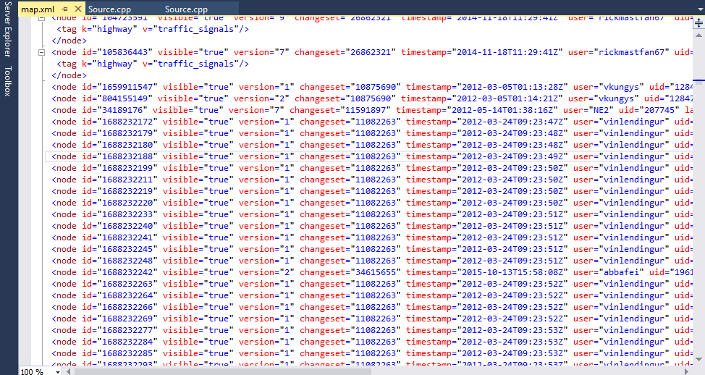
Current Status: Path Planning
Extracted data from OpenStreet Map in .osm format

Slide 30
Project Management

Slide 31
Fall Validation Experiments: Perception
Step ID | Step Description | Success Condition | Conditions
PE.1 | Start RGB video of field test | This is our ground truth | Location: NSH Demonstration on laptop (Simulation), Projector required
PE.2 | Simultaneously replay and visualize saved raw radar data in ROS | We can see plots of the radar image
PE.3 | Show filtered data | The filtered image has less noise than the raw image
PE.4 | Demonstrate obstacle detection | Draw bounding box around the obstacles.
PE.5 | Show detected objects from radar image while showing recorded video | The radar should detect obstacles that are in the video, at least the boats

Slide 32
Fall Validation Experiments: Path Planning and Simulator
Step ID | Step Description | Success Condition | Conditions
PL.1 | Interfacing with IMU/GPS | Display logged data from IMU/GPS which we would be collecting during a field test | Location: NSH Demonstration on laptop (Simulation), Projector required
PL.2 | Generate Environment Map | Display occupancy grid map for 2 miles with filled blocks depicting obstacles (For one of the rivers of Pittsburgh)
PL.3 | Demonstrate Path Planning | Boat successfully navigates from Point A to Point B in simulator which are 1 mile apart
PL.4 | Show obstacle avoidance | Boat successfully avoids obstacles in simulator in the above task. Obstacles are static and are simulated through occupancy grip map

Slide 33
Spring Validation Experiments: Script for final demo
Step ID | Step Description | Success Criteria | Conditions
SV.1 | Get the boat on the river | Location: center of width | Location: Allegheny River (Exact location is yet to be provided by the sponsor) Equipment /Arrangements: Boat, Radar, IMU/GPS, Fuel, Laptop in boat, Camera to record video, safety driver
SV.2 | Keep 5 static obstacles in the path | Size more than 2mx2mx2m
SV.3 | Switch on the engines and start AutoPirates autonomous system | The system starts successfully
SV.4 | Enter the destination through OCU | OCU takes the location correctly
SV.5 | The boat navigates autonomously and avoids obstacles | Boat avoids at least 4 obstacles
SV.6 | The boat arrives the destination | Boat arrives to destination (15 mts radius)
SV.7 | Show logged file | Play back logged data
SV.8 | Turn off the autonomous system and engine | System switches off without any error

Slide 34
Budget Allocation
Hardware/Equipment/Budget provided by the sponsor (NREC)
S.No | Part | Part Name | Quantity
1 | Boat | 2015 SeaHawk OS 2700S | 1
2 | Radar | SimRad 4G FMCW Radar | 1
3 | Lidar | Velodyne VLP-16 | 1
4 | IMU/GPS | Novatel SPAN with IMU positioning | 1
5 | Laptop | Dell i7 | 5
6 | Proprietary Boards | SBC and Microcontroller boards | 2
7 | Trails for testing | $800 per trial | 25 (trails)
From RI Budget $4000
S.No | Name | Description | Quantity | Cost | Total
1 | Transportation | Travel to NREC (5 people) | 64 | 25 | 1600
2 | Videography | Professional video of the final run | 1 | 500 | 500
3 | Backup for Trails | Incase we run out of allotted 25 trails | 2 | 800 | 1600
4 | Miscellaneous | To buy camera, contraption, books, etc | 1 | 300 | 300

Slide 35
Work Breakdown Structure
Autonomous Water Taxi
Perception
Path planning
Mapping & Localization
Simulator
Integration
OCU
Testing
Project Management
Get data from Radar
Interface IMU/GPS
Import external navigation map
Generate a world model
Integrate OpenCPN with ROS
Input destination and waypoints
Sensor test
Task scheduling
Position and pose estimation
Algorithms test
Field management
Filter data
Generate occupancy grid map
Generate a boat model
Integrate SBPL library with external map
show obstacles
Morphological operation
Interface SBPL library
Field test
Budget management
Localize boat on the map
Apply path planning algorithm to the boat model
show real-time location
Integrate perception with path planning
Performance evaluation
Risk management
Contour extraction
Algorithm evaluation
Overlay radar image on the map
show estimate path
Obstacle detection
Send command to low-level controller
Evaluate performance for obstacles avoidance

Slide 36
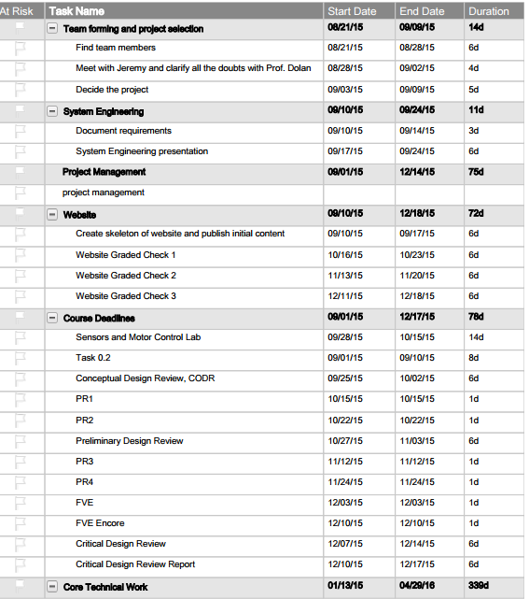
Schedule: 1

Slide 37
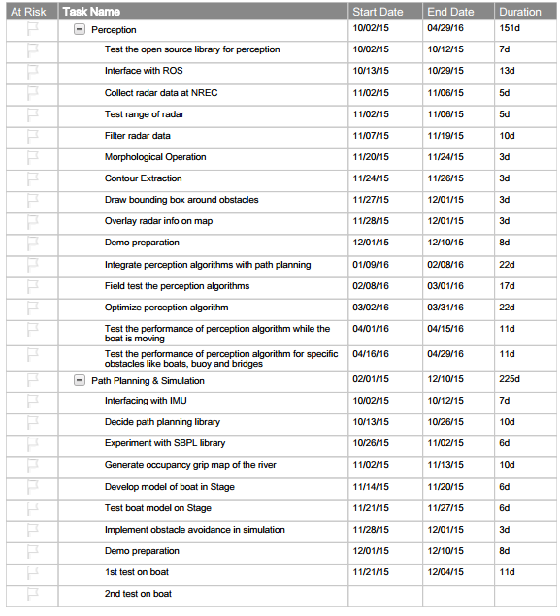
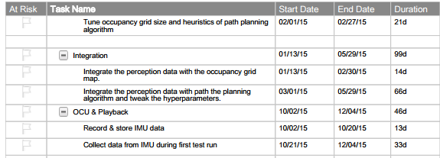
Schedule: 2

Slide 38
Risk Assessment
Risk ID | Risk Title | Req | Type | Description | Impact Statement | Likeli- hood (1-5) | Conse- quences(1-5) | Mitigating Actions
1 | Test environment availability | All | Testing | Won’t be able to do field testing because of weather conditions | Delay in the progress and insufficient data collect for algorithms | 4 | 3 | Test radar perception on shore for static obstacles. Use a simulator for path planning
2 | Limited testing trials | MNFR2 | Project management | Only 25-30 field tests | Unable to do system integration before demonstration | 5 | 3 | Appoint a field manager to plan logistics of each test.
3 | Radar Performance | MF2, MF3, DF1, DF2 | Technical | Radar signal is too noisy | Inadequate object detection with only radar | 3 | 4 | Incorporate additional sensors like Lidar and camera
4 | Localization accuracy | MF4, MF5 | Technical | Path planning algorithm relies on precise localization. GPS performance might be not as good as expected. | Poor estimation of the environment and poor navigation performance. | 3 | 5 | filter GPS data; limit the maximum speed of the boat

Slide 39
Risk Assessment
Risk ID | Risk Title | Req | Type | Description | Impact Statement | Likeli- Hood (1-5) | Conse- Quences (1-5) | Mitigating Actions
5 | Insufficient boat protection | All | Testing | No automatic stop in case of a possible collision | The boat will collide with obstacles | 2 | 5 | Develop fail-safe software module
6 | Technical support from NREC | All | Technical | Limited availability from NREC engineers | It takes time for NREC engineers to fix hardware problems or to provide guidance for software | 4 | 3 | Ask for software documentations
7 | Team Communication | All | Project management | Language barrier in the team | It may be difficult to express ideas. | 4 | 2 | Do more preparations before the meetings

Slide 40
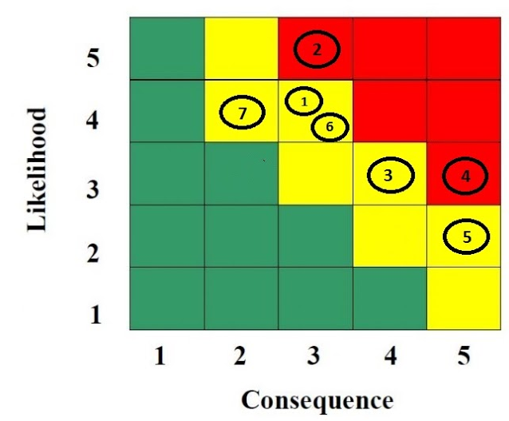
Risk Assessment

Slide 41
Questions

